Slide 1
Final Project
Milestone Week 4 Update
Trevor Lau, Celine Semaan, Alexander Williamson, & Jenna Rutberg

Slide 2
Initial Assembly
As we are all in different places and are machines are still being built, we have not yet created a physical assembly.
We have instead planned out what we will construct later this week.

Slide 3
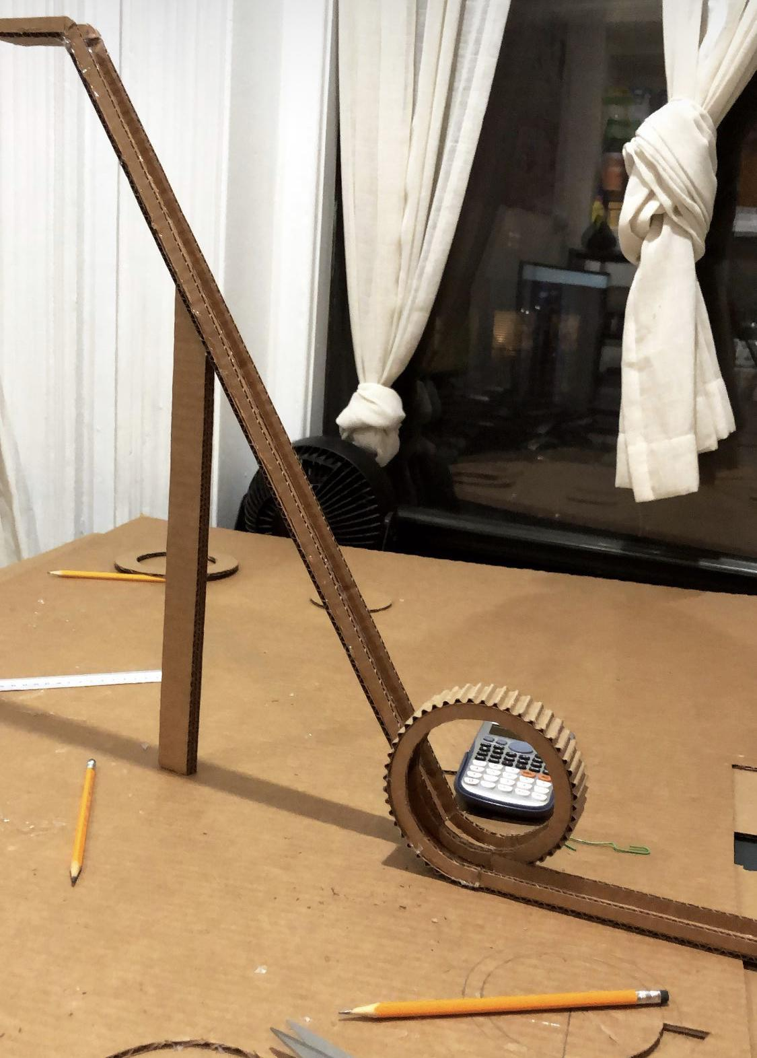
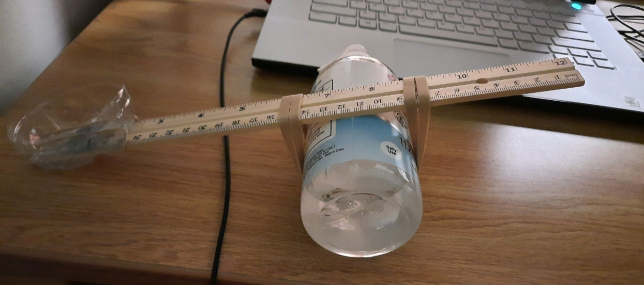
Initial Assembly Step 1 & 2
Step 2
Step 1

Slide 4
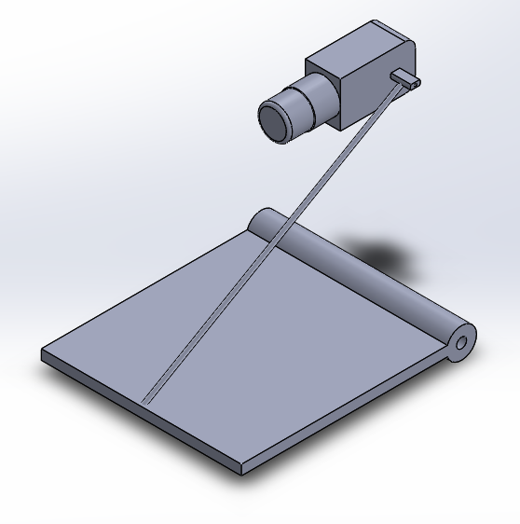
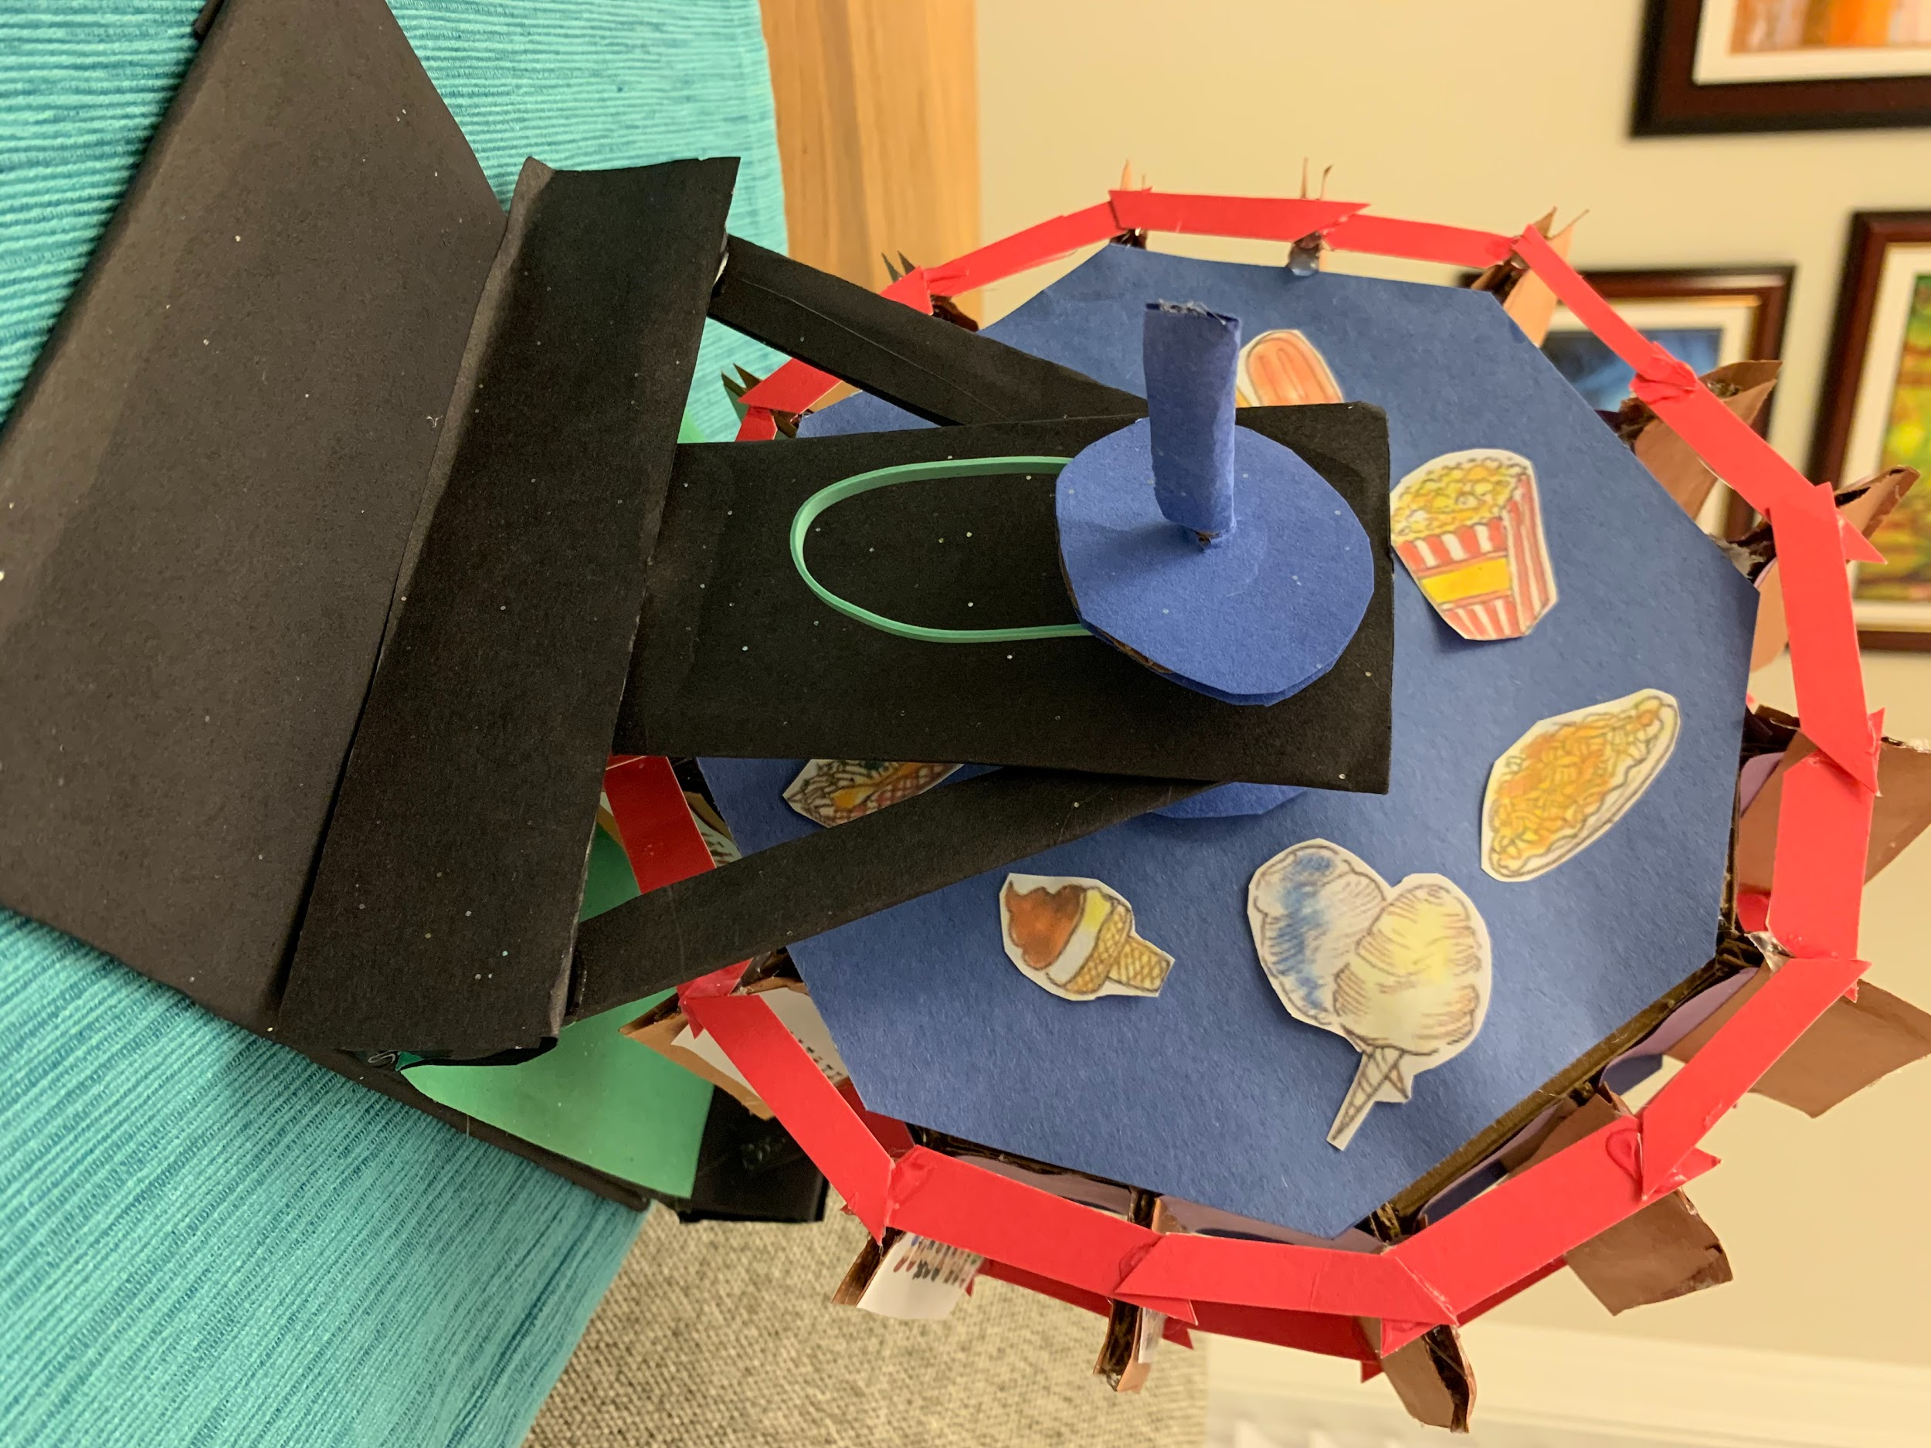
Initial Assembly Step 3 & 4
Step 3
Step 4

Slide 5
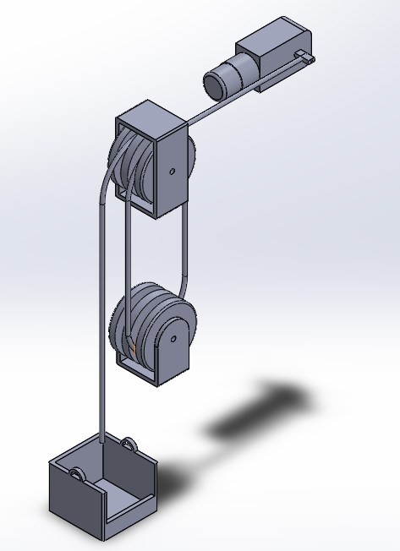
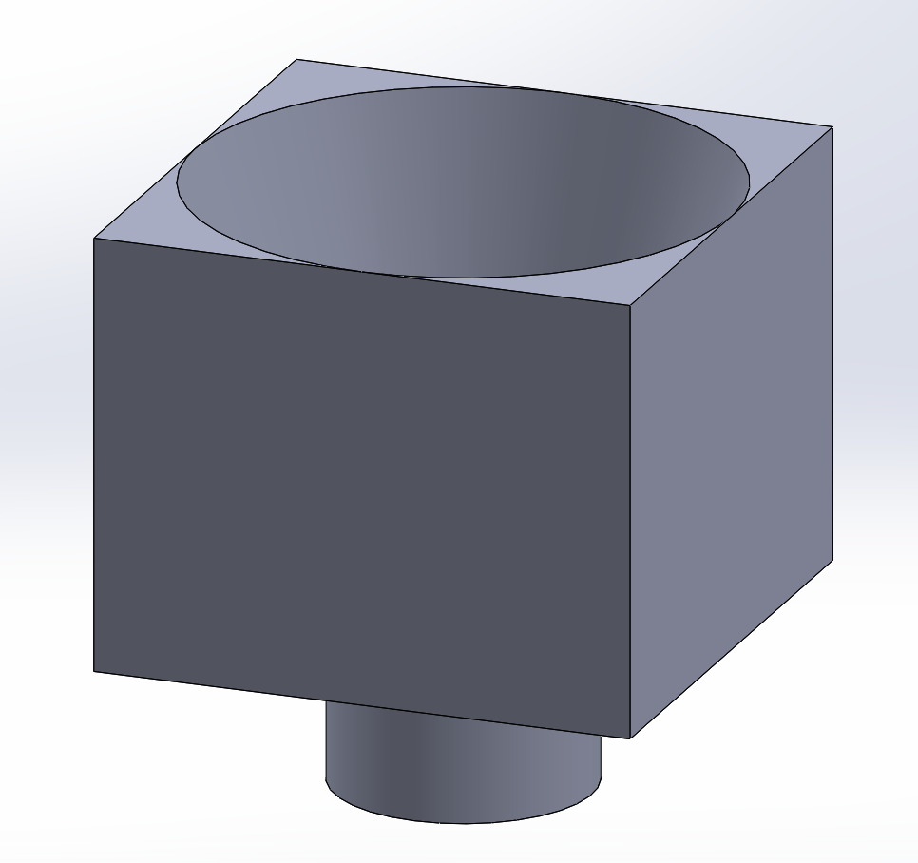
Initial Assembly Step 5 & 6
Step 5
Step 6

Slide 6
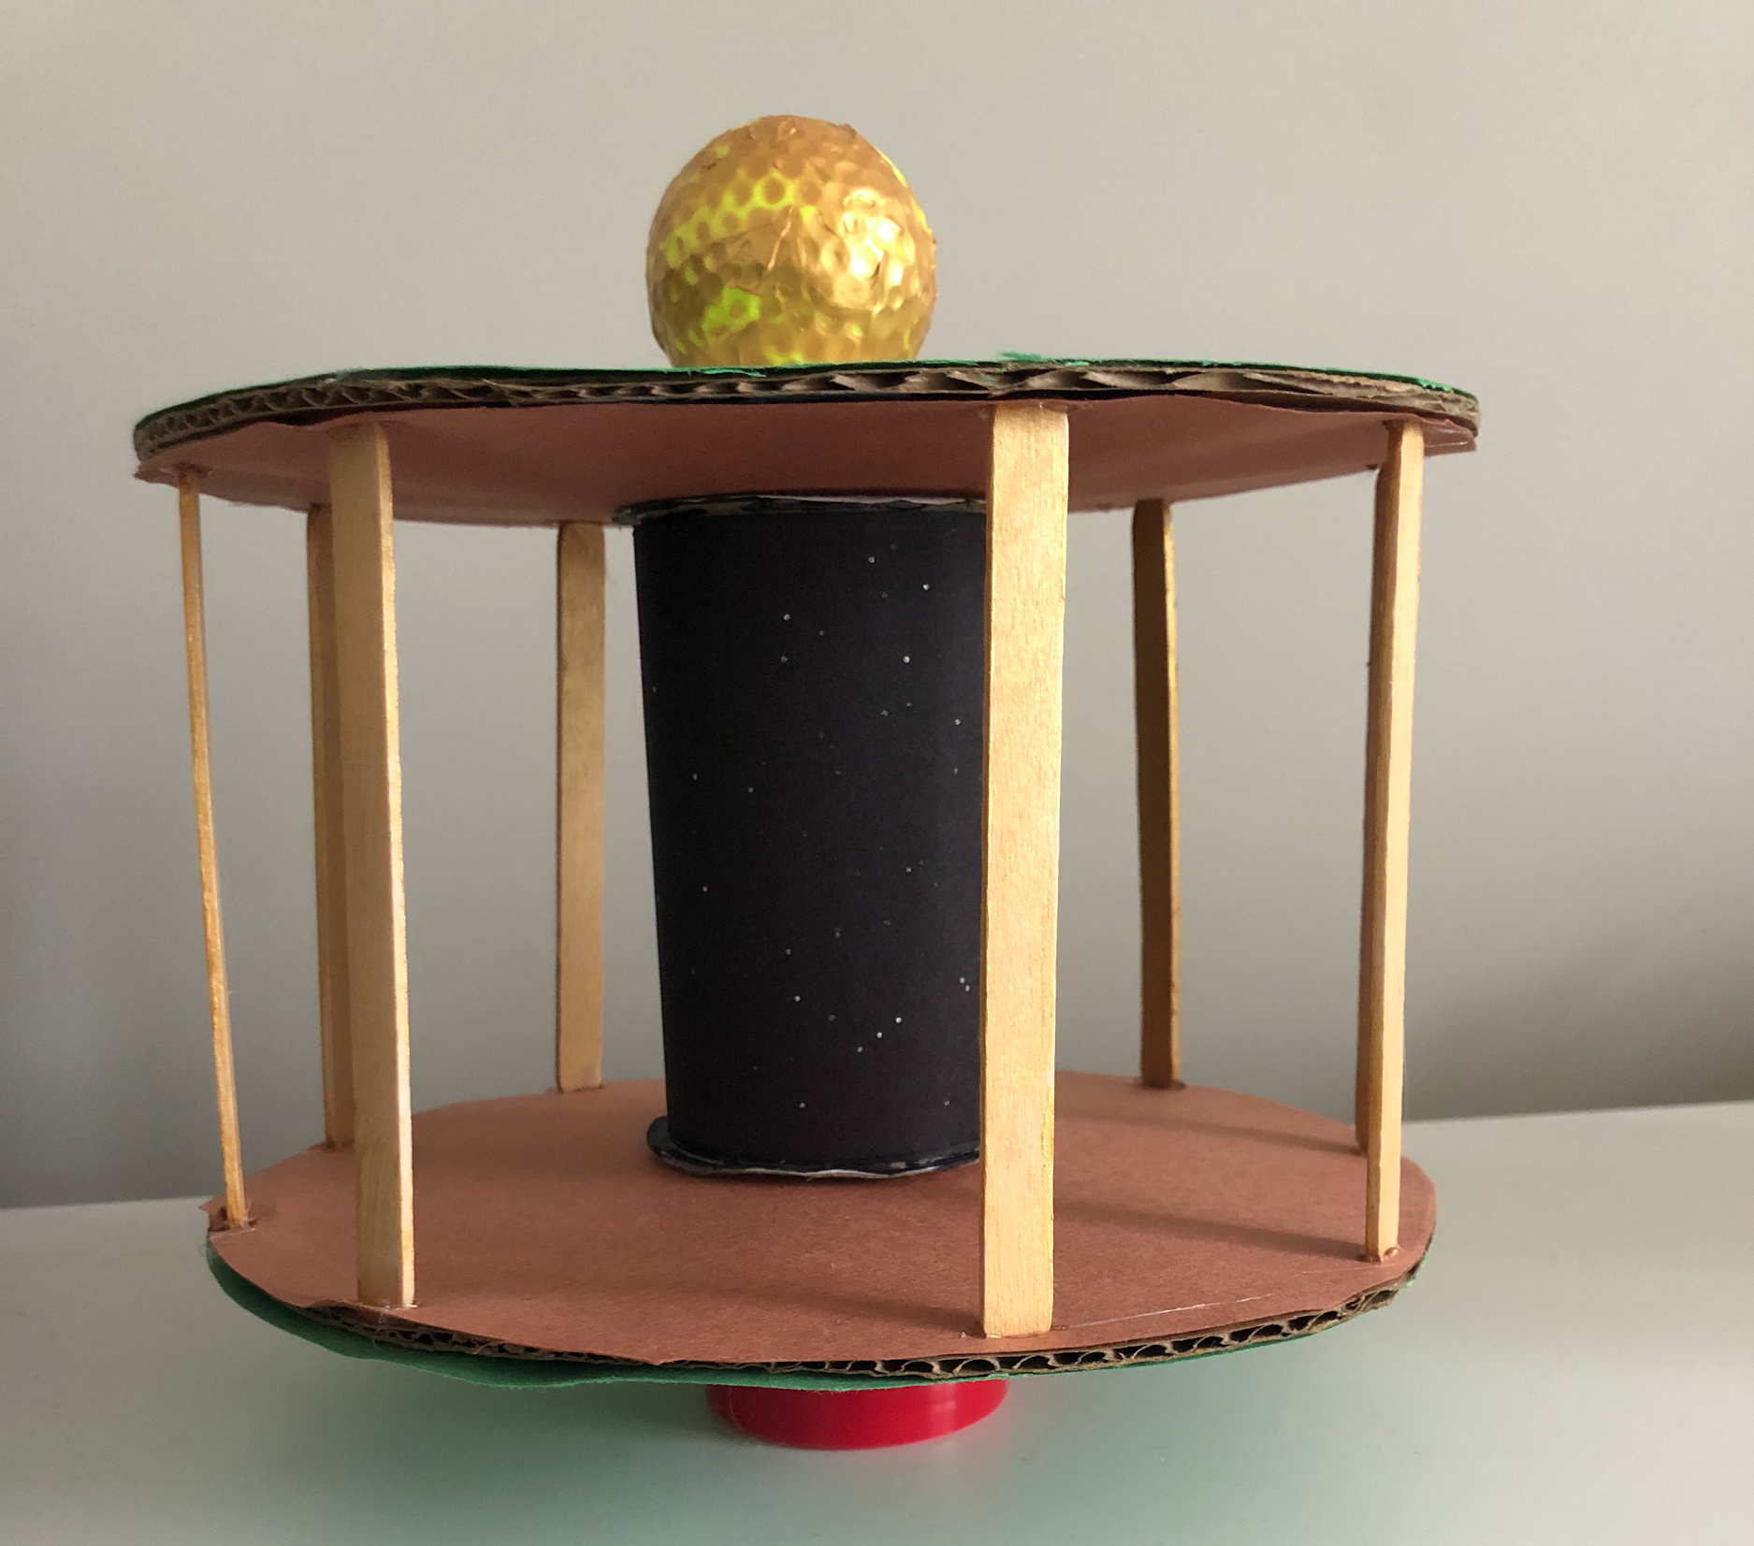
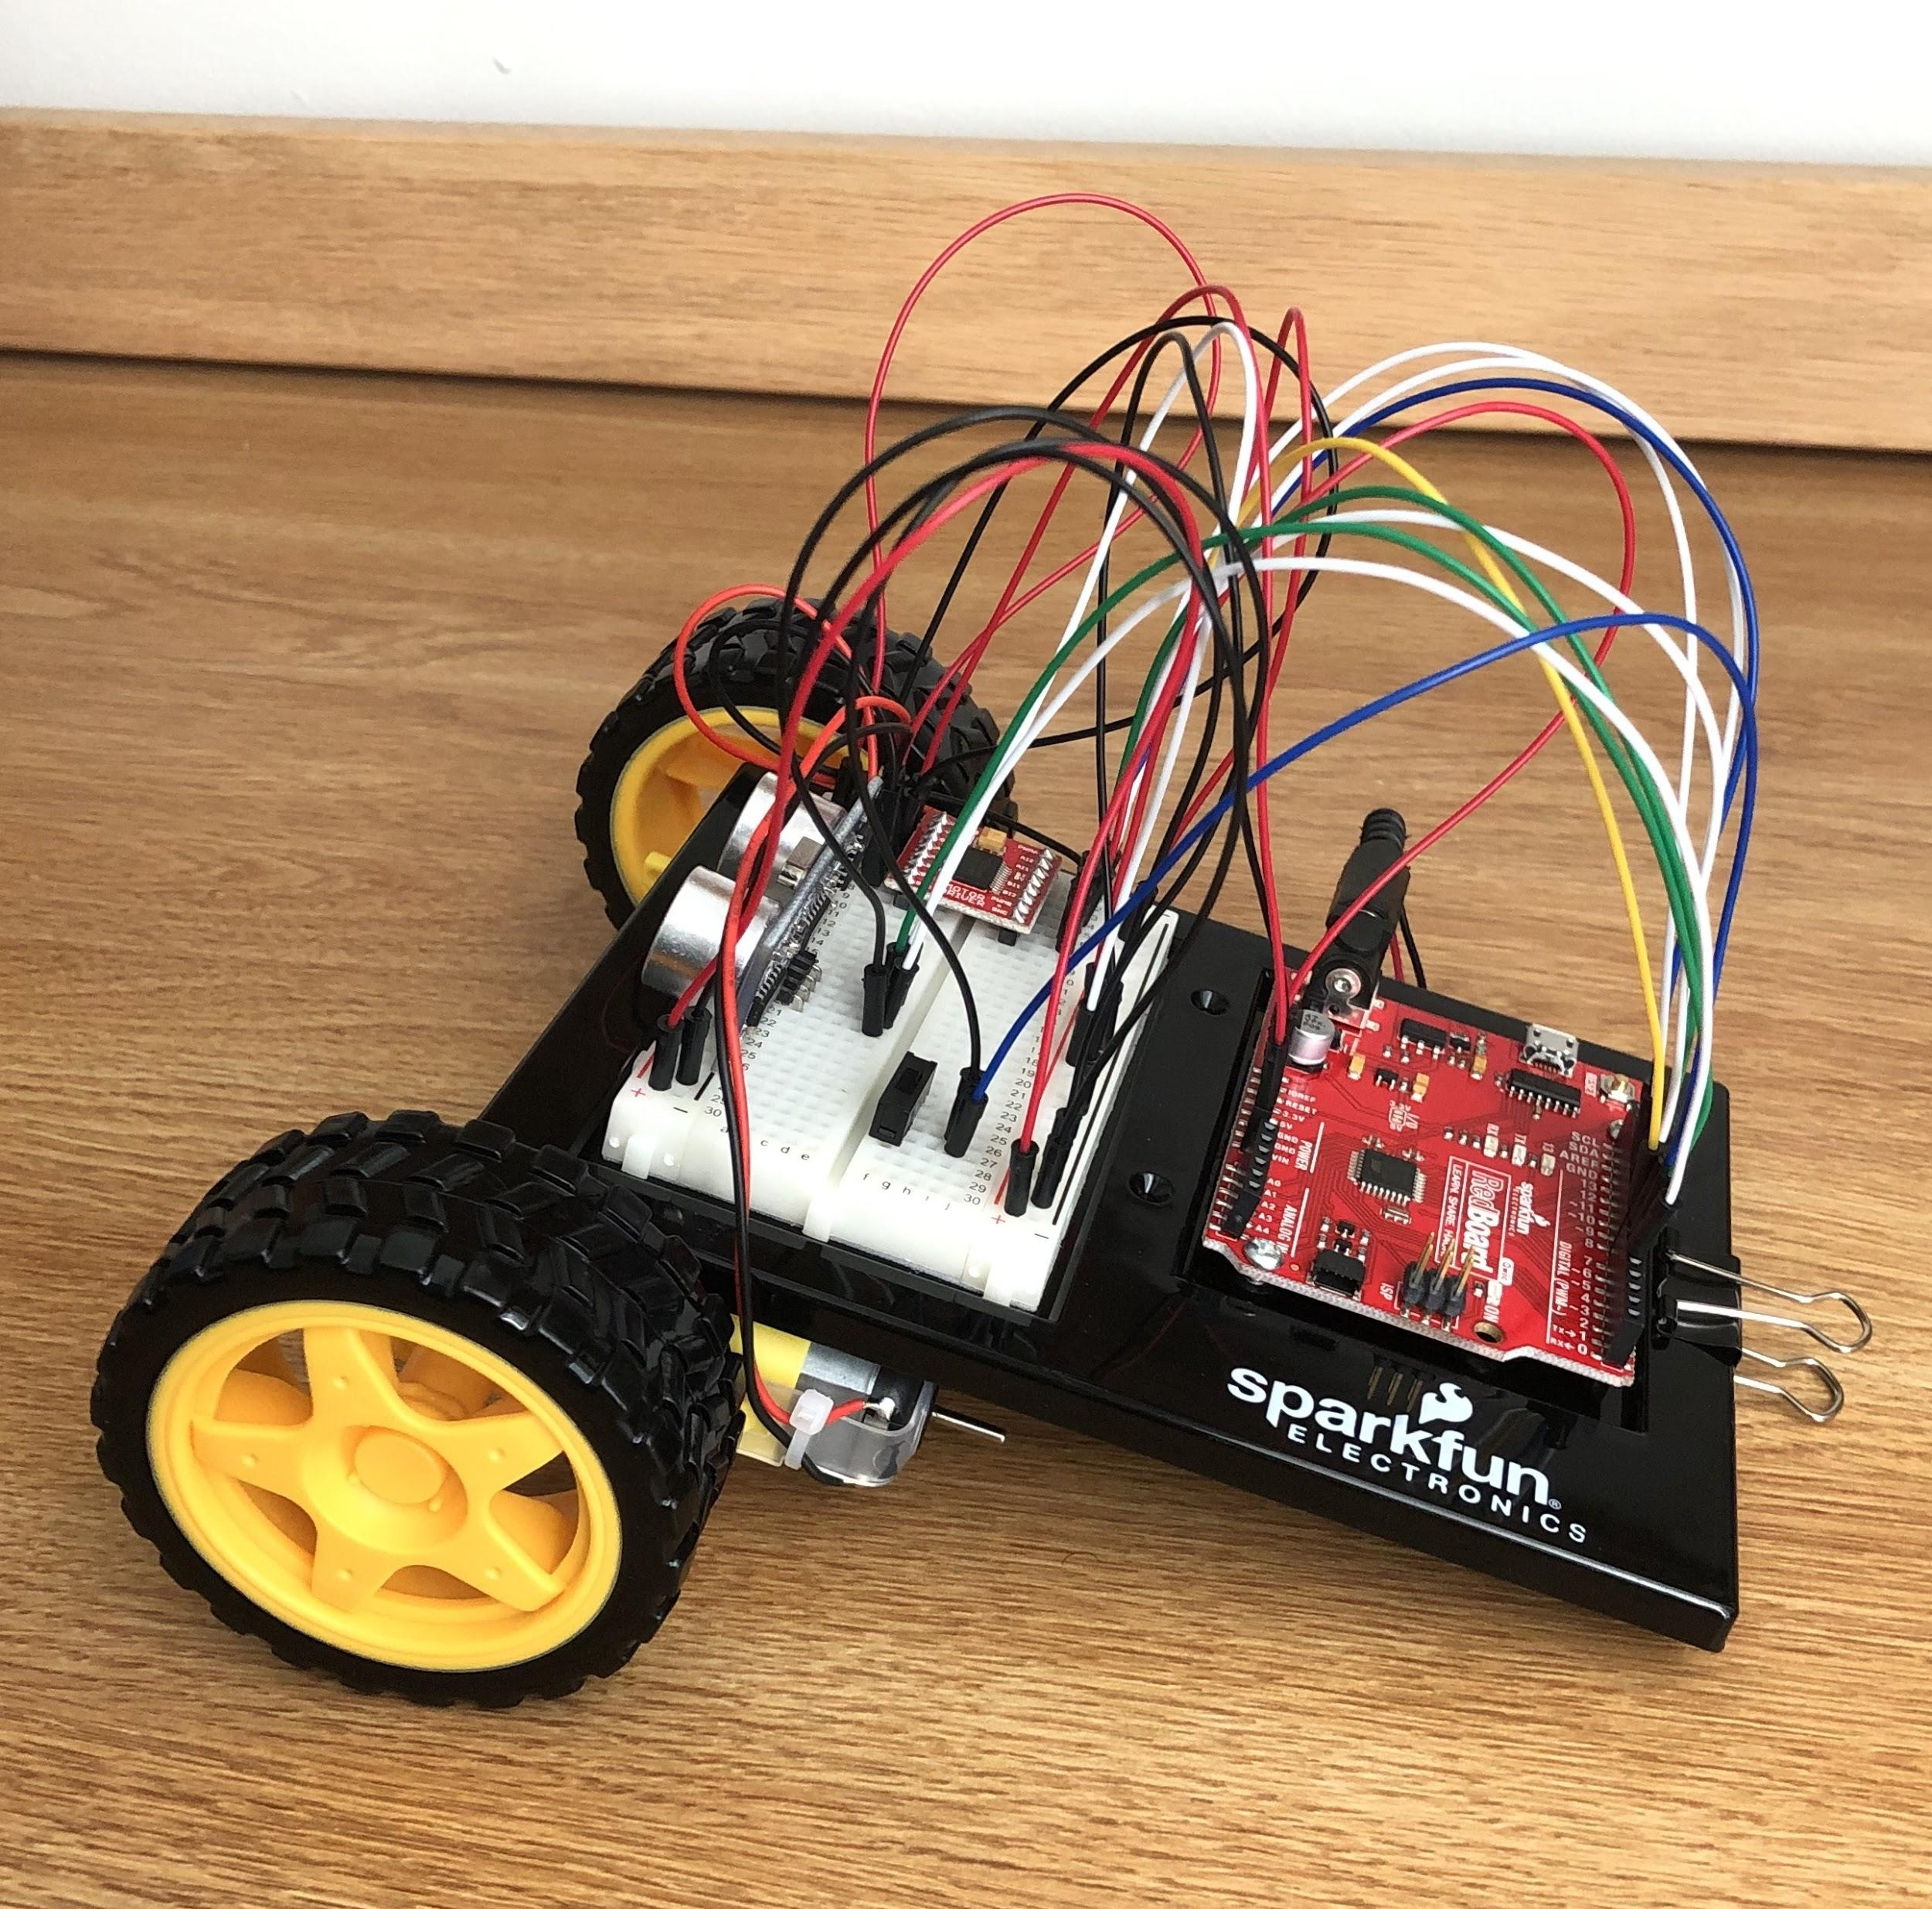
Initial Assembly Step 7 & 8
Step 7
Step 8

Slide 7
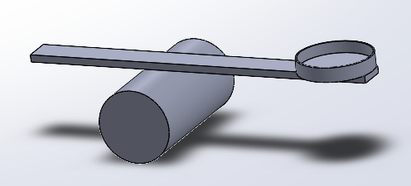
Catapult Update
Circumference of pivot was increased -> lower release angle
Length was shortened, to simplify construction

Slide 8
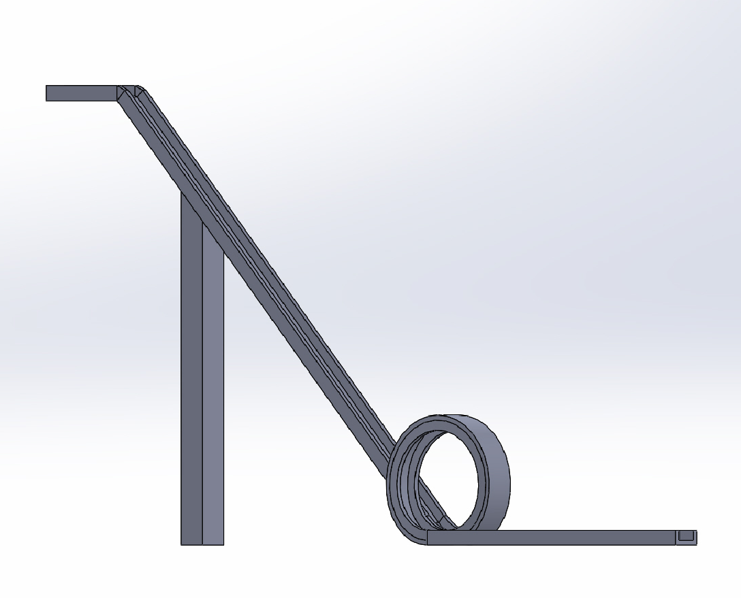
Loop Update
Modifications to the original design:
Height of the hill
was increased.
The hill is at a steep angle.
Hopefully, this ensures a
successful prototype.

Slide 9
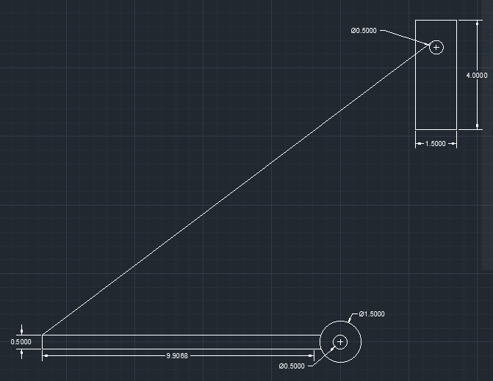
Drawbridge Update

Slide 10
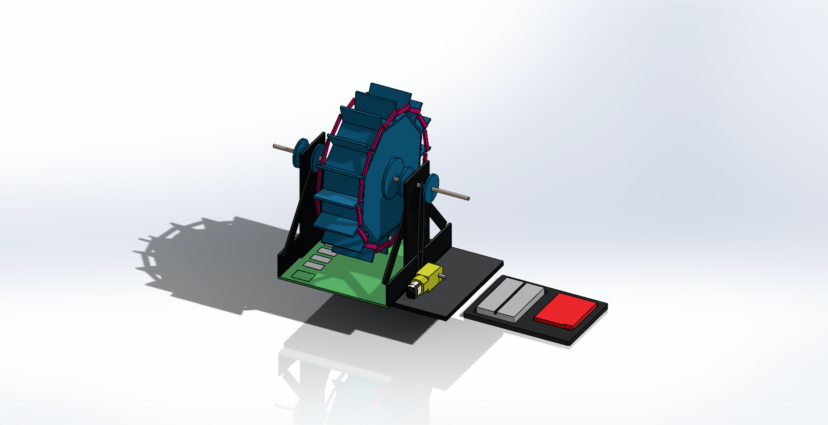
Ferris Wheel Update
The Ferris Wheel has a working Final Design.
Notes:
Improvements:
-lighter design compared to prototype
-program still needs to be updated with correct motor speed

Slide 11
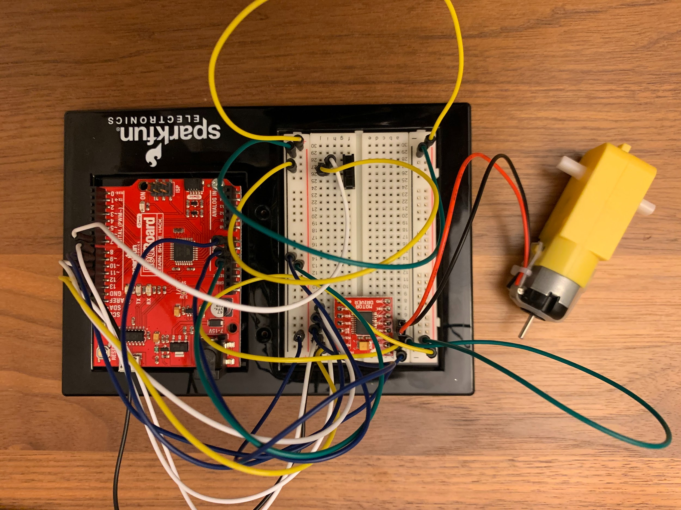
Ferris Wheel Update
Ferris Wheel Final Design

Slide 12
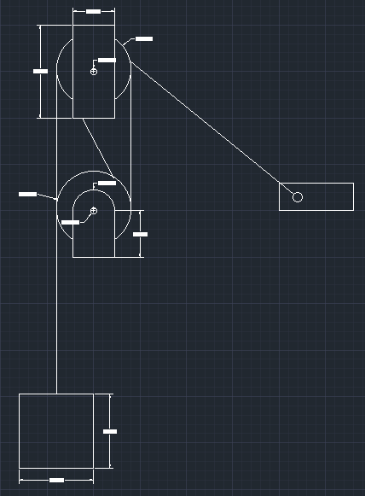
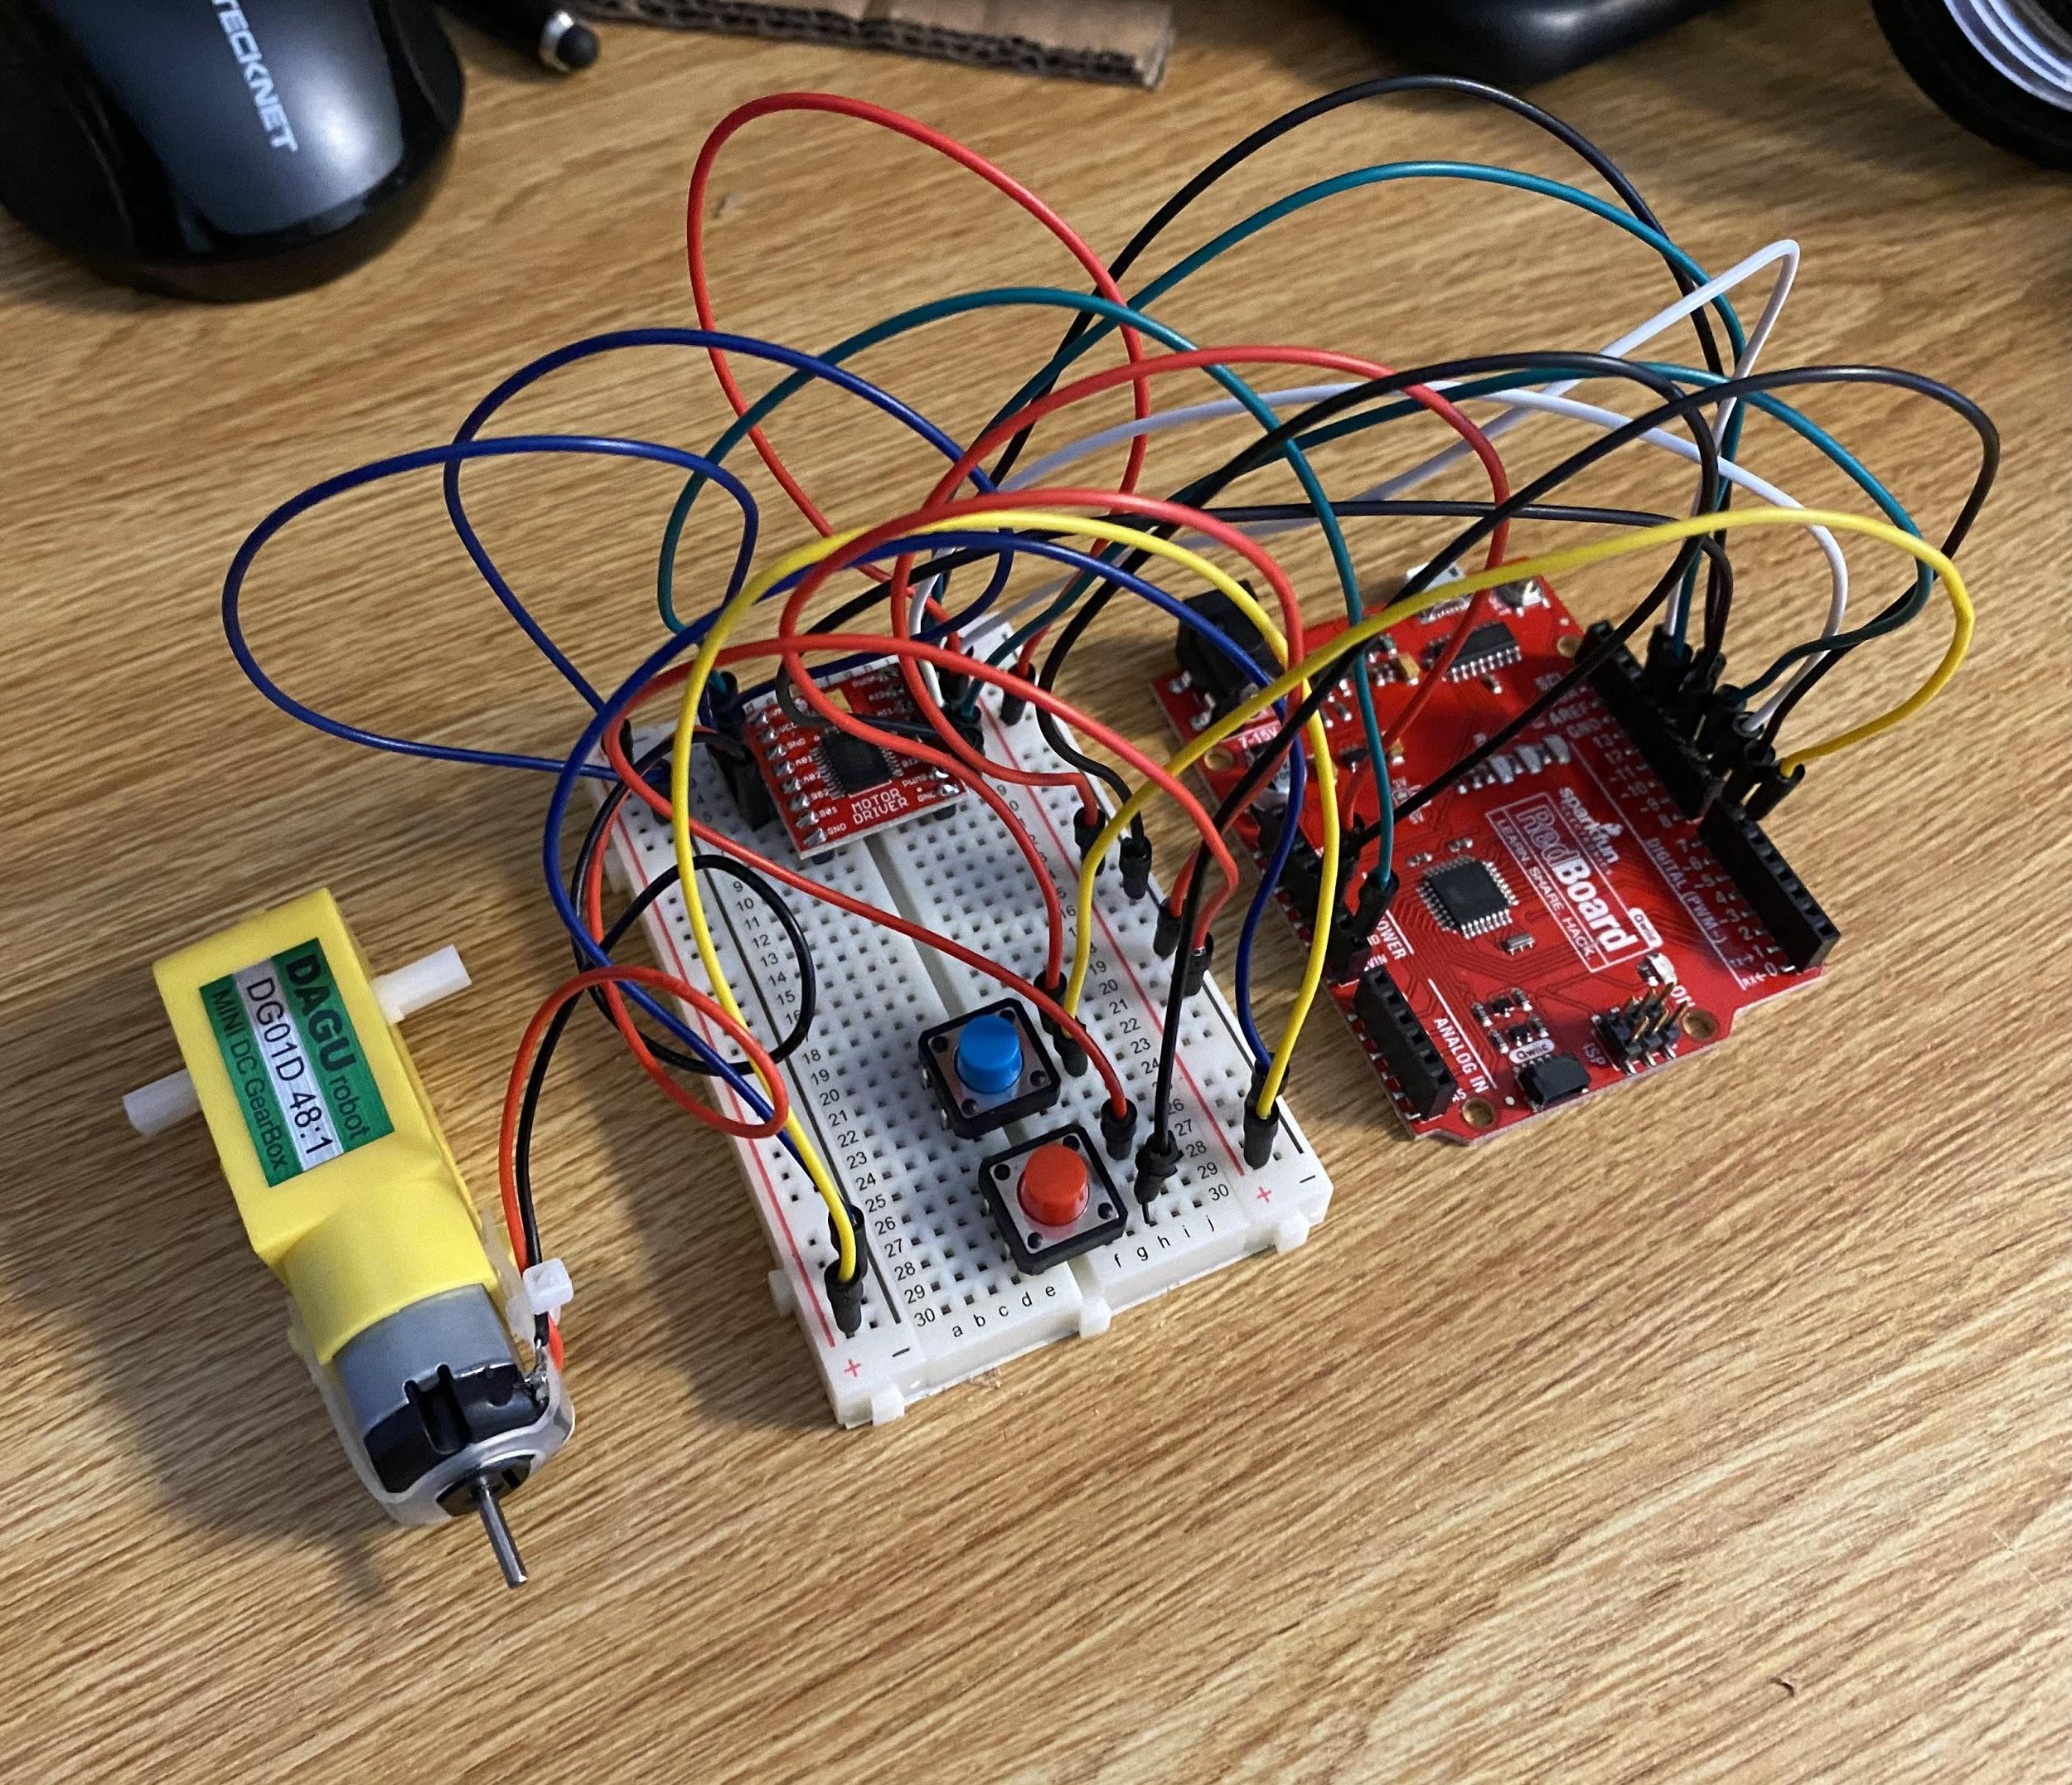
Pulley Update

Slide 13
Merry-Go-Round Update
The Merry-Go-Round has a working prototype, but the base needs to be adjusted in the final design to better support the axle.
The construction of the final design will be completed today.

Slide 14
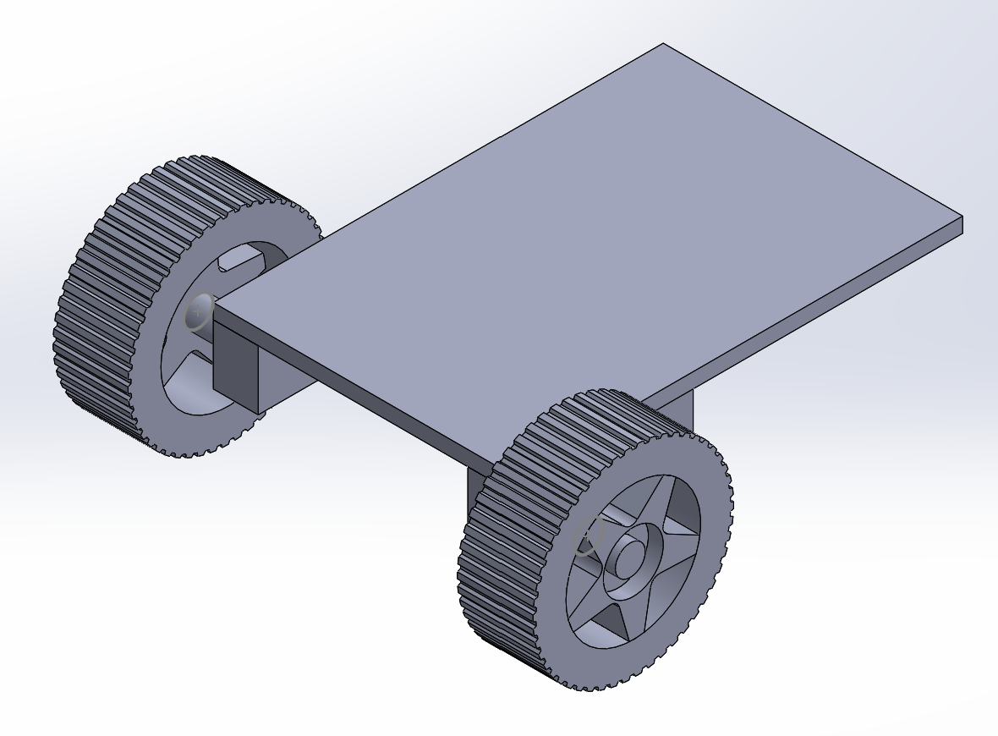
Sparkfun Robot Car Update
The Sparkfun Robot Car is built.
We are currently working on the program to make its trajectory a circle that goes around the Merry-Go-Round.

Slide 15
Demo
As we are still working on the final designs of each machine, we have not yet tested the machines together.
We plan to complete this task later this week.

